Slide 1
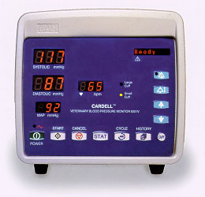
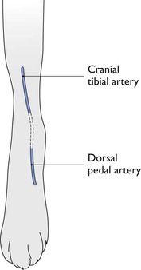
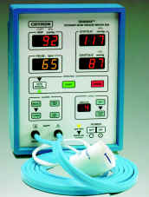
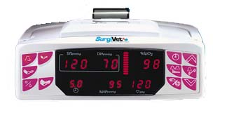
Monitoring of blood pressure
Indirect Oscillometric Blood Pressure Measurement
■ Indirect
Oscilometric
Doppler
■ Direct

Slide 2
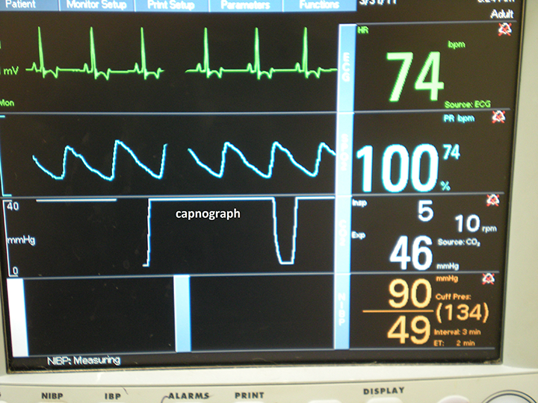
Respiratory system
■ Respiratory rate
■ Pulse oximeter
(pulse and oxygen saturation)
■ Blood gas analyzer
-Pa O2
-Pa CO2
-pH
-Bicarbonate
■ Capnometer or Capnography

Slide 3
Ideal injectable anesthetic
■ 1- physicochemical
a. water soluble
b. long shelf life
c. stable when exposed to light
d. small volume required for induction
■ 2- pharmacodynamics
a. minimal individual variation
b. safe therapeutic ratio
c. onset, one vein to brain circulation time
d. short duration of action
e. inactivated to nontoxic metabolites
f. smooth emergence
g. absence of anaphylaxis
h. absence of histamine release
■ 3- no effects on vital organ function

Slide 4
Injectable anesthetics
● Chloral hydrate
● Barbiturates
● Ketamine

Slide 5
Chloral hydrate
● Colorless crystals
● Water soluble , Alkaline
● Cardiac depressant, hepatotoxic
● Respiratory depressant
● Solution 6-10 %
● Dose: 100-150 mg/kg
● Prolong recovery, nystagmous

